Slide 1

Smart Plant Irrigation System
Presented by:
DIVYA SINGH 20102019
Under the Supervision of:
Ms MONIKA
Department of ECE
Jaypee Institute of Information Technology, Noida, U.P., India
1

Slide 2
Abstract
The automatic plant monitoring system has recently attracted tremendous interest due to the potential application in emerging technology.
This helps in providing the appropriate amount of water for plants so reduces some situations like mud cracks, water logging.
This also helps in irrigating the ﬁeld even during night time, so does not require the farmer to switch ON the motor manually.
Smart irrigation systems are a combination of an advanced technology of sprinklers with nozzles that improve coverage and irrigation controllers that are watering and water conservation systems that monitor moisture-related conditions on your property and automatically adjust watering to optimal levels.
There are two general types of smart irrigation technology: weather based and soil moisture based. Both can help you save water, but there are some important differences.
2

Slide 3
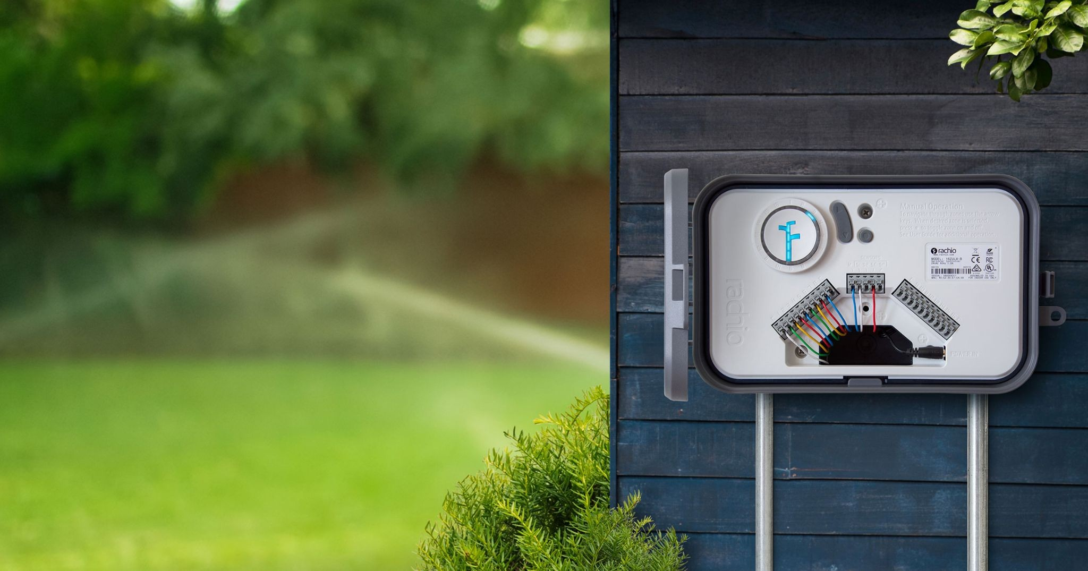
Weather-Based Smart Irrigation Technology
Also known as ET-based technology, a weather-based irrigation system includes either a mini on-site weather station or weather sensor
capable of monitoring conditions such as temperature, rainfall, and solar radiation on your property.
Depending on the model, the sensor hardware requires an existing controller be replaced with a weather-based controller with the technology integrated into the controller or come as an add-on receiver to your existing controller.
Typically the sensors are quite small and can be mounted inconspicuously on a building, fence post or other object in your yard.
Most have wireless communication between the sensor and the controller.
They are relatively expensive.
In addition to the water savings, the increase in plant health, which has the potential to reduce the money spend on treating plant health problems, can be signiﬁcant enough to more than warrant the expense.
Fig 1-Weather-Based Smart Irrigation Technology
3

Slide 4
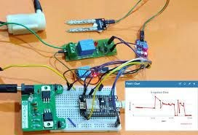
Moisture-Based Smart Irrigation Technology
This technology uses sensors to measure the actual moisture content of the soil.
There are two distinct types of moisture-based systems available.
The first, referred to as suspended-cycle irrigation, uses a traditional timed and automated watering schedule. The only difference is that it doesn’t allow watering to happen if the soil moisture threshold is too high. However, if the soil is too dry it won’t adjust the pre-programmed schedule to allow for additional watering. Many of these sensors can be added to an existing traditional controller.
The second type of moisture-based smart irrigation system is a water-on-demand system. This one maintains two soil moisture thresholds – high and low – and automatically calls for water as needed to maintain soil moisture between the two. This type requires that the existing controller be replaced with a controller with its own sensors.
Fig 2-Moisture-Based Smart Irrigation Technology
4

Slide 5
Irrigation is a process of providing the desire amounts of water to the agricultural land.
This process is very beneﬁcial in minimizing runoffs or drought
Why Smart Irrigation System?
situations for the crops cultivation.
Due to alarming changes in the
climate, farmers cannot rely on natural rainwater.
Irrigation is important to yield good
quality crops in the seasonal or non-seasonable period.
5

Slide 6
For modern agriculture, a smart Plant irrigation system is one of the best techniques that give more production in minimum duration.
To many extend, this smart irrigation system is designed and fully automated to minimize manual handling in agriculture.
And one of the good things is that it is very comfortable for users (or farmers)to understand the concept of IoT and sensors for smart irrigation.
It can help you to learn how various sensors can be deployed and utilization of their data to generate events and control irrigation systems.
6

Slide 7
I will be working on Moisture-Based Smart Irrigation Technology
6

Slide 8
Proposed Work
Initially we have to collect the analog output value from the soil moisture sensors.
And we have to ﬁx a particular threshold value for particular sensors.
If the output analog value is greater than the threshold value, then it indicates that the soil is dry condition.
So we have to switch on the water motor. The water motor is used to pump water to dry sectors to make them wet by using relay, which will be acting as the switch.
Water is pumped into the dairy sector until entire soil will be becoming wet. After a particular time the dry soil becomes wet.
If the output of the soil moisture sensor is less than the prescribed threshold values it indicates the soil is wet condition. So that water motor will come into switched off.
7

Slide 9
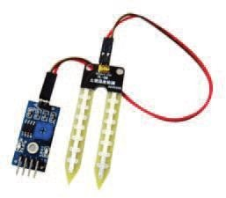
Components Used in Project
SOIL MOISTURE SENSOR:
The basic soil moisture consists of two electrodes, and those probes are kept in the soil.
When the soil consists of water, as water is a good conductor of electricity, so water acts as a short circuit path for those two electrodes.
As a result current ﬂows between those electrodes and generates a voltage across the variable resistor. So the conductance values are the moisture content readings of the sensor.
As it consists of NOT gate so it generates high values for dry soil, i.e. which doesn’t contain moisture and produces lower values for wet soil. Soil moisture measures the volumetric water content in soil.
Fig 3-Soil Moisture Sensor
8

Slide 10
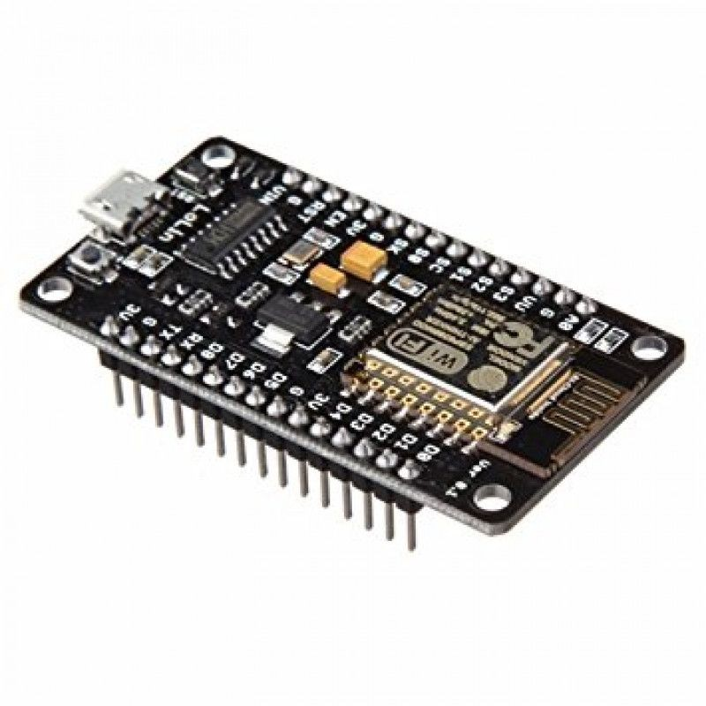
NodeMCU
It is an open source development board and ﬁrmware based in the widely used ESP8266 -12E WiFi module.
It allows you to program the ESP8266 WIFI module with the simple and powerful LUA programming language or Arduino IDE.
With just a few lines of code you can establish a WiFi connection and deﬁne input/output pins according to your needs exactly like arduino, turning your ESP8266 into a web server and a lot more. It is the WiFi equivalent of ethernet module.
Now you have internet of things (iot) real tool. With its USB-TTL , the nodeMCU Dev board supports directly ﬂashing from USB port. It combines features of WIFI access point and station + microcontroller.
These features make the NodeMCU extremely powerful tool for Wiﬁ networking. It can be used as access point and/or station, host a webserver or connect to internet to fetch or upload data.
Fig 4-NodeMCU
9

Slide 11
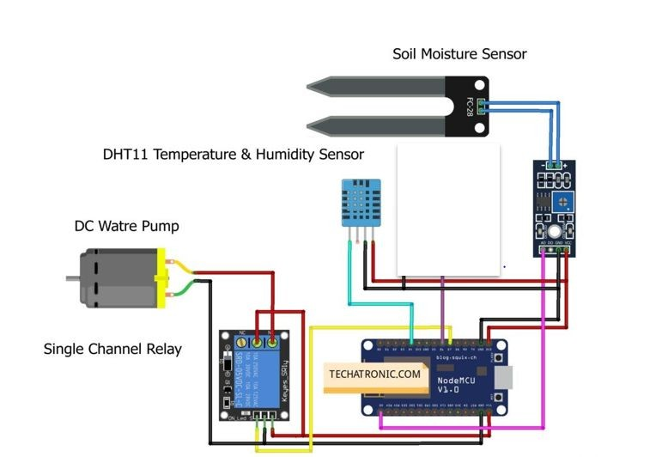
Circuit Diagram
Fig 7-Circuit Diagram
10

Slide 12
Flow Chart
START
SOIL MOISTURE SENSOR VALUE S
T R U E
MOTOR ON
IF S>X
F
A L S E
MOTOR OF
STOP
STOP
11

Slide 13


It can provide high accuracy water supply and avoid water from wastage.
The smart plant irrigation system is user friendly platform to learn and enhance your skill about smart watering system.
Due to automatically handling, user requires less manpower.
Advantages
Of Smart
Irrigation
System
using IoT
With the help of the sensors, it can accurately determine the soil moisture levels.
This system automatically provides water supply to the ﬁeld. User can manually operate (turn ON or OFF) valve.
12

Slide 14
GLOBAL SCOPE
Our project Smart irrigation system is need to be adapted globally.
Today, discussions about climate change, drought and ﬂash ﬂooding as well as how these phenomena affect agriculture and water rights dominate public discourse.
Simultaneously, regulatory agencies worldwide are starting to require sustainable farming practices while economic competition is omnipresent.
Intersectoral competition is taking place on a global scale while water resources are becoming scarcer in speciﬁc regions, yet more variable and extreme in others. It is therefore important for agricultural practice to become more resource-eﬃcient.
Physical, technical, digital and ﬁnancial factors accompany this enormous task – one that will ultimately deﬁne the stability of the water-energy-food nexus for both today’s society and future generations.

Slide 15
There is a need for smart irrigation systems all over the world.
As different places have different
climate, soil and the amount of water it is important that the smart irrigation system is made considering all these things so that it can be used world wide.
Modern advancements in irrigation allow farmers and agricultural workers to supply water to their land directly and efficiently water their crops.
How the project is a Global scope project?

Slide 16
Water management remotely is also challenging task, especially the management becomes more difficult during the shortage of water, which may otherwise damage the crop.
By using sensors like moisture water supply for irrigation can be managed easily by analyzing the condition of soil and climate.
Soil moisture sensors smartly measure the soil moisture and based on that data, field is irrigated automatically with less human interventions. The farmer is also given the power to control, when the water should be stopped through his phone.
There are a lot of countries suffering from extremely high baseline water stress therefore is a need for the global adaptation of smart irrigation practices

Slide 17
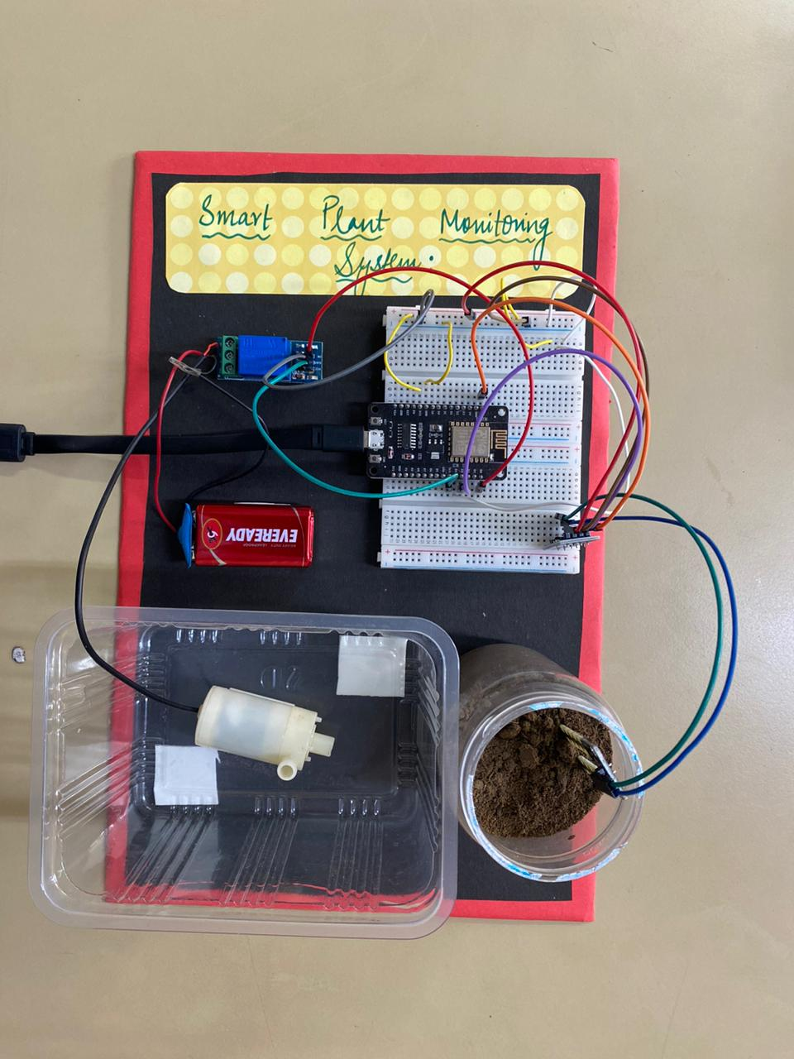
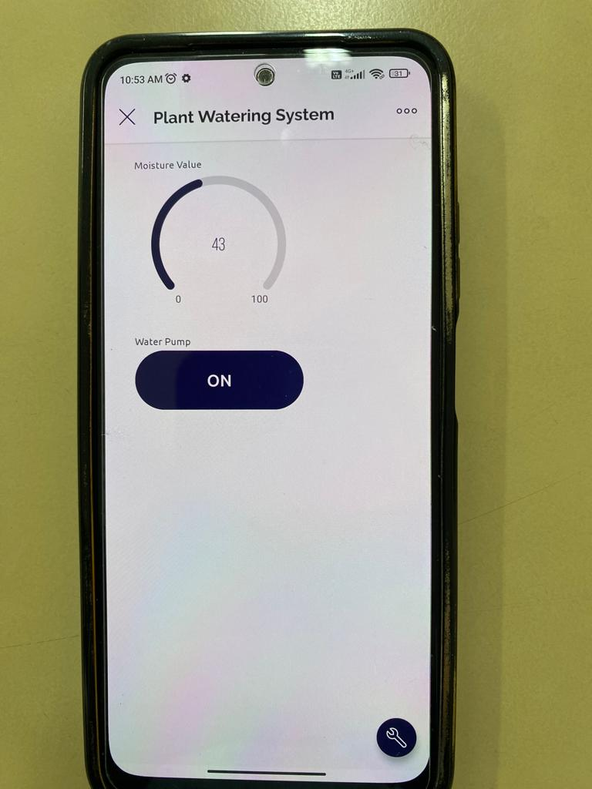
OUTPUT

Slide 18
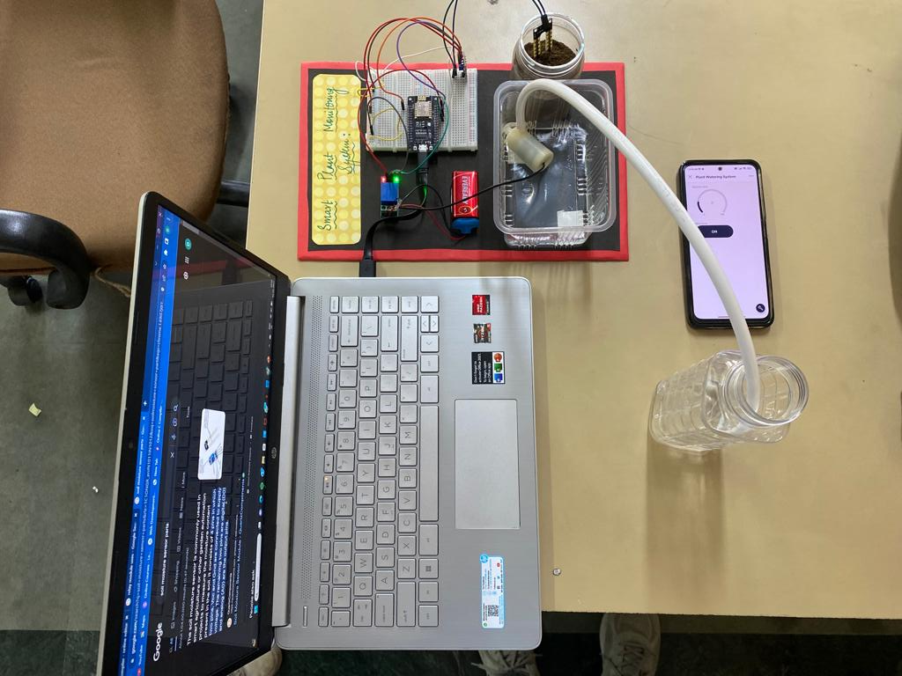

Slide 19
References
N. A. M. Leh, M. S. A. M. Kamaldin, Z. Muhammad and N. A. Kamarzaman, "Smart Irrigation System Using Internet of Things," 2019 IEEE 9th International Conference on System Engineering and Technology (ICSET), 2019, pp. 96-101, doi: 10.1109/ICSEngT.2019.8906497..
K. K. Kishore, M. H. Sai Kumar and M. B. S. Murthy, "Automatic plant monitoring system," 2017 International Conference on Trends in Electronics and Informatics (ICEI), 2017, pp. 744-748, doi: 10.1109/ICOEI.2017.8300802
Blog- Farmer-led irrigation: the what, why, and how-to guide https://blogs.worldbank.org/water/farmer-led-irrigation-what-why-and-how-guide
https://ieeexplore.ieee.org/document/8300802
https://www.loveyourlandscape.org/expert-advice/water-smart-landscaping/smart-irrigation/shopping
-for-a-smart-irrigation-system/
https://www.epa.gov/watersense/weather-based-irrigation-controllers
https://circuitdigest.com/microcontroller-projects/iot-based-smart-irrigation-system-using-esp8266-an d-soil-moisture-sensor
https://www.google.com/search?q=SOIL+MOISTURE+SENSOR:&rlz=1C1RXQR_enIN988IN988&source
=lnms&tbm=isch&sa=X&ved=2ahUKEwjpkq7Rs9D6AhXUTmwGHW3KD38Q_AUoAXoECAEQAw&biw=1 536&bih=722&dpr=1.25#imgrc=cH7Enh6tRXjuNM
https://circuitdigest.com/microcontroller-projects/iot-based-smart-irrigation-system-using-esp8266-an d-soil-moisture-sensor

